Slide 1


JAVA Java Interview boot camp Core concepts
Lecture 20
CHAPTER 21
Nested/Inner Classes

Slide 2
What Is A Nested Class ?
Classes defined within the body of another class (or interface) are known as nested classes.
Normally we define a class, which is a top-level class directly belonging to a package.
In contrast, nested classes are classes contained within another class or interface.

Slide 3
Example
public class Car {
// members of Car
class Engine {
// members of Engine
}
}

Slide 4
Benefits Of Nested Class
Grouping Related Code Together:
Some classes are only useful to others, e.g. the Engine class and Car class in the above example.
By using nested classes, related code is grouped together which gives us more flexibility and controllability in writing code.

Slide 5
Benefits Of Nested Class
Increasing Code Encapsulation:
Consider the previous example - the nested class Engine is encapsulated inside the Car class, which protects the Engine class from the outside world.

Slide 6
Benefits Of Nested Class
Making the code more readable and maintainable:
Indeed, nested classes help us write more readable and maintainable code, as shown in the above example: when reading to the Car class, we can also navigate to the Engine class and make update quickly within the same source file.

Slide 7
Benefits Of Nested Class
Better Event Handling Code:
Nested classes are sometimes useful for specific purposes.
For example, anonymous inner classes are useful for writing simpler event-handling code with AWT/Swing

Slide 8
Types Of Nested Classes
There are four types or flavours of nested classes in Java:
• Static nested class
• Inner class
• Local inner class
• Anonymous inner class

Slide 9
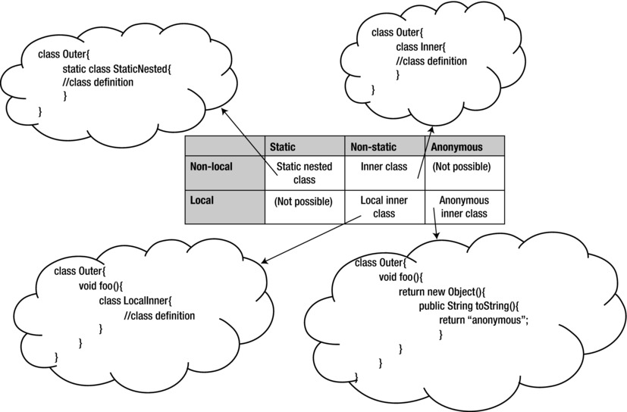
Types Of Nested Classes

Slide 10
Types Of Nested Classes
A local class is defined within a code block (code block means a method, constructor, or initialization block)
A non-local class is defined inside a class.
A static class is qualified using the static keyword.
A non-static class does not use this static keyword with the class definition.
In an anonymous class, we don’t provide the name of the class; we just define its body!

Slide 11
Types Of Nested Classes
static nested classes are static and non-local, whereas inner classes are non-static and non-local.
A non-static and local nested class is a local inner class, and a local and anonymous nested class is an anonymous inner class.

Slide 12
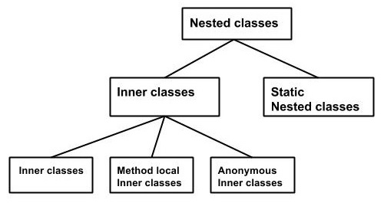
Types Of Nested Classes

Slide 13
Static Nested Class
We can define a class (or interface) as a static member inside another class (or interface).
Since the outer type can be a class or an interface and the inner ones can also be a class or interface, there are four combinations.

Slide 14
Four Types Of Static Nested Class/Interface
class Outer { // an outer class has a static nested class static class Inner { } } interface Outer { // an outer interface has a static nested class static class Inner { } } class Outer { // an outer class has a static nested interface static interface Inner { } } interface Outer { // an outer interface has a static nested interface static interface Inner { } }

Slide 15
Static Nested Class
A nested class is marked with static modifier is called the static nested class.
Here’s an example:
public class Car {
static class Wheel {
public void rotate() {
System.out.println("The wheel is rotating...");
}
}
}

Slide 16
Static Nested Class
Here, Wheel is a static nested class which is enclosed in the Car class.
The following code illustrates how to instantiate an object of the static nested class:
Car.Wheel wheel = new Car.Wheel();
wheel.rotate();

Slide 17
Exercise
Create a static nested class called Color declared inside a class called Shape.
Provide three data members called red , green and blue in the class Color and a parametrized constructor to initialize them with the values passed.
Also provide an overridden toString() method.
Finally inside the main() method instantiate the Color class and display the details of the objects

Slide 18
Solution
class Shape { public static class Color { int red, green, blue; public Color(int red, int green, int blue) {
this.red=red;
this.green= green;
this.blue = blue; }
public String toString() { return " red = " + red + " green = " + green + " blue = " + blue; } } }

Slide 19
Solution
public class TestColor { public static void main(String []args) {
Shape.Color white = new Shape.Color(255, 255, 255);
System.out.println("White color has values:" + white); }
}
Output:
White color has: red = 255 green = 255 blue = 255

Slide 20
Points To Remember About SNC
Static nested classes are sometimes referred to as static inner classes, but they aren't inner classes at all, by the standard definition of an inner class.
A static nested class does not have that special-relationship that inner classes have, i.e. they cannot access the instance methods or variables of outer class.

Slide 21
Points To Remember About SNC
public class Car {
private int weight;
private static String brand;
static class Wheel {
public void rotate() {
// cannot access instance variables of the enclosing class
weight = 5;
// can access static members of the enclosing class
brand = "Honda";
}
}
}

Slide 22
Points To Remember About SNC
As we can see, the static nested class cannot have direct access to instance members of the enclosing class.
However it can access these members via object reference of the enclosing class.

Slide 23
Points To Remember About SNC
public class Car {
private int weight;
private static String brand;
static class Wheel {
public void test(Car car) {
car.weight = 5000;
System.out.println("car's weight is: " + car.weight);
}
}
}

Slide 24
Points To Remember About SNC
The class is not static (a class cannot be static), the static modifier in this case says that the nested class is a static member of the outer class.
That means it can be accessed, as with other static members without having an instance of the outer class.
The name of the static nested class is expressed with OuterClassName.NestedClassName syntax.

Slide 25
Points To Remember About SNC
When we define an inner nested class (or interface) inside an interface, the nested class is declared implicitly public and static.
This point is easy to remember: any field in an interface is implicitly declared as public and static, and static nested classes have this same behavior.

Slide 26
Points To Remember About SNC
Static nested classes can be declared abstract or final.
public class GeoLocation {
public static abstract class LocationResult{
public abstract void gotLocation(Location location);
}
}
Static nested classes can extend another class or it can be used as a base class.

Slide 27
Points To Remember About SNC
For example , to use the class LocationResult, we could create a class extending it using extends as shown:
class MyLocation extends GeoLocation.LocationResult { . . . }
and use it with
GeoLocation.LocationResult instance = ...

Slide 28
Points To Remember About SNC
Static nested classes can access the members of the outer class (only static members, obviously).
The outer class can also access the members (even private members) of the nested class through an object of nested class.
If we don’t declare an instance of the nested class, the outer class cannot access the nested class elements directly.

Slide 29
What Is The Use Of Static Nested Class?
Static nested class is used in the builder pattern.
Static nested class can instantiate it's outer class even if it has a private constructor.
We can not do the same with the inner class as we need to have object of the outer class created prior to accessing the inner class.

Slide 30
What Is The Use Of Static Nested Class?
class OuterClass {
private OuterClass(int x) {
System.out.println("x: " + x);
}
static class InnerClass {
public static OuterClass createOuter() {
OuterClass outer = new OuterClass(1);
return outer;
}
}
}
public class Test {
public static void main(String[] args) {
// It is not possible to create outer instance from outside.
// OuterClass outer = new OuterClass(1);
OuterClass outer=OuterClass.InnerClass.createOuter();
}
}

Slide 31
Why Do We Need Builder Design Pattern When We Already Have Factory Pattern ?
There are three major issues with Factory design patterns , when the object contains a lot of attributes:
Passing too many arguments to Factory class from client program can be error prone.
Its hard to maintain the order of the argument.
Some of the parameters might be optional but in Factory pattern, we are forced to send all the parameters and optional parameters need to send as NULL.

Slide 32
Example
public class Computer {
//required parameters
private String HDD;
private String RAM;
//optional parameters
private boolean isGraphicsCardEnabled;
private boolean isBluetoothEnabled;
}
Challenge:
Write code to initialize object of Computer class in a single line of code

